Slide 1
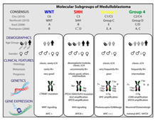
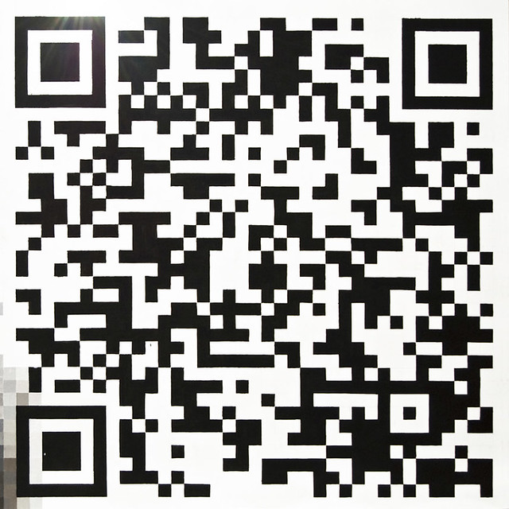
POSTER TITLE Authors: First LastName¹, First LastName^{1,2}, First LastName ¹ Authors’ Affiliation ² Authors’ Affiliation
Reminder: the size of your poster shall be 4’ x4’ ft max
BACKGROUND
RESULTS
Point #1
Point #2
Table 1
Table 2
Demographics
PURPOSE / OBJECTIVES
Figure 1
Figure 2
Primary objective:
Secondary objective:
Cell surface proteins
Adoptive cell transfer with
CAR-engineered T-cells
METHODS
CONCLUSION
Aj;djf;ajdkfj;adk;
Akldj;ajdlfj; aj
Ajkd;fj;aldjf; ja;l j;adj ;l
In this pilot study, aj;kjdf;lakj l;kja;j ;aj
ACKNOWLEDGEMENT
QR code that link to your ePoster on VoiceThread Website
Notes:
Template

